Slide 1


SMART ATTENDANCE SYSTEM USING QR CODE
IDEA LAB PROJECT PRESENTATION
Presented by :
Harsh Netam ( E -17, URN-300102220032 )
Kunal Kanwar ( E-27, URN -300102220045 )
Shubham Debnath ( E-27,URN -300102220099 )
Rohit Kushwaha ( F-64, URN -300102220127 )
Under Guidance of :
Dinesh Bhawnani Sir
Kauleshwar Prasad Sir

Slide 2

SMART ATTENDANCE SYSTEM
USING QR CODE

Slide 3

TABLE OF CONTENTS
1 . INTRODUCTION
2 . METHODOLOGY
3 . SPECIFICATION
4 . SCOPE AND APPLICATION

Slide 4

INTRODUCTION

Slide 5

PROBLEM STATEMENT :-
Inefficient and time-consuming procedures are used to record students' attendance in higher education. When the class size is large, it is more difficult to control the process. Even tougher to regulate is the prevention of attendance fraud. It becomes considerably more difficult to manage if each class lecturer is required to take attendance. Following each lesson, lecturers are required to enter the attendance data from the attendance sheets into a corresponding web-based system. Lecturers' important time is being eaten up by the entire procedure of obtaining attendance. Universities are not altering the way they track attendance despite the issues raised above.
GOAL:-
Reduce administrative and lecturers labor manually and minimize paper usage.

Slide 6

OBJECTIVE
To simplify the current attendance-taking process by automating the process using QR code scanning.
Increase the transparency of attendance records by enabling students and lecturers to view attendance records anytime.
Reduce cheating on attendance by enforcing cheat detections.
Minimise paper usage by eliminating the need for attendance sheets.
QR -CODES

Slide 7

METHODOLOGY

Slide 8
The proposed solution is by taking attendance using QR code
HOW TO IMPLEMENT:-
Proposed Approach
Display QR
code
Generate QR code
Update database after verification
Phone
QR
DB
Scan QR
code
Send for
verification
Scanner

Slide 9

SPECIFICATION

Slide 10
This chapter discuss about system flow, use case and project requirement.
System flow:-
INPUT
PROCESS
OUTPUT
INPUT
PROCESS
OUTPUT
Click “Generate QR
code”
Generate QR
code
Display QR
code
Scan QR
code
Validate QR
code
Display message
success/failure
STUDENT
Server
Mobile
LECTURER
Server
WEB

Slide 11

FUNCTIONAL REQUIREMENTS:-
Lecturer
The system shall be able to scan QR codes.
The system shall be able to manage attendance records.
The system shall be able to manage the class.
Students
The system shall be able to generate QR codes.
The systems shall be able to check attendance records.
NON FUNCTIONAL REQUIREMENTS:-
The system shall prevent cheating attendance by verifying the request.
The system shall prevent unauthorized login on the user account.
The system shall be fast and responsive

Slide 12
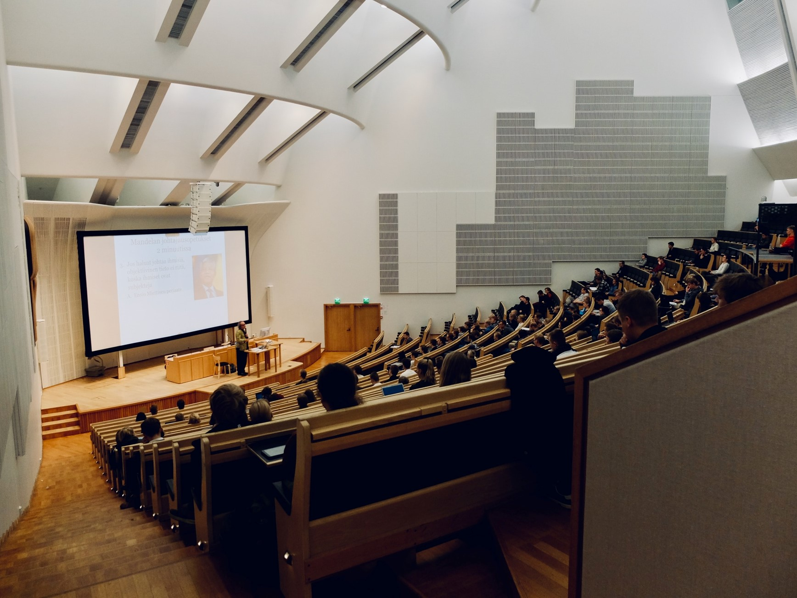
SCOPE
AND APPLICATION

Slide 13

SCOPE
The scope of this project is to study the basic of making a better attendance system. The main goal of this project is to develop a QR code system technology scanner by using a webcam attached to a computer. This system is able to read and display the QR code. Software will be used to create the interface and a database is used to store the data that being created using correct framework and software. An applications that integrates the attendance system though the computer for checking the absent of students in real time will developed. The process will also include design and implementation of the database system to record the data.

Slide 14
Applications of the Proposed System :
The calculation of the absentee rate is easier and more accurate; all
calculations are performed by computer rather than manually.
2) There will be no paper work involved; all processes are performed by
computer. This will help protect against loss of data.
3) The computerized processes will be performed more quickly and accurately
than the previous system.
4) The proposed system eliminates the notice board. Absentee rates can be
viewed weekly by scanning an easily accessible QR code.

Slide 15

THANK YOU

